Slide 1



Miri Company
Presentation
CDAL Research
Yosemite_summer2winter
Image Classification, GAN, Diffusion Model
www.miricanvas.com

Slide 2
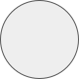
Miri Company
Presentation
CONTENTS
1
2
3
4
Dataset
CNN Model
GAN Model
Diffusion Model
· Train, Test Dataset
· Feature 분석
· Data Pipeline 설계
· Image Augmentation
· ResNet Transfer Learning
· Data Pipeline & Image Augmentation
· Generator & Discriminator Class
· Train, Model save
· Ran out of GPU

Slide 3
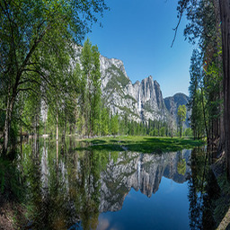
Miri Company
Presentation
1
Dataset
This dataset was obtained from UC Berkeley's official directory of CycleGAN Datasets
File Path 구성
Train, Test Split
Image Size
📦summer2winter_yosemite ┣ 📂test ┃ ┣ 📂test_summer ┃ ┗ 📂test_winter ┗ 📂train ┣ 📂train_summer ┗ 📂train_winter
Summer: 1540 images
Winter: 1200 images
train_summer: 1231 images
train_winter: 962 images
test_summer: 309 images
test_winter: 238 images
Size: 256 X 256

Slide 4
Miri Company
Presentation
1
Dataset
This dataset was obtained from UC Berkeley's official directory of CycleGAN Datasets
File Path 구성
Train, Test Split
Image Size
📦summer2winter_yosemite ┣ 📂test ┃ ┣ 📂test_summer ┃ ┗ 📂test_winter ┗ 📂train ┣ 📂train_summer ┗ 📂train_winter
Summer: 1540 images
Winter: 1200 images
train_summer: 1231 images
train_winter: 962 images
test_summer: 309 images
test_winter: 238 images
Size: 256 X 256

Slide 5
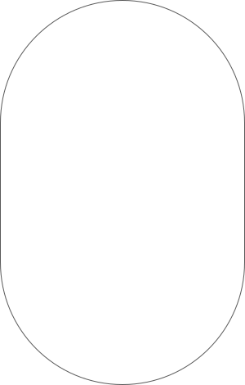
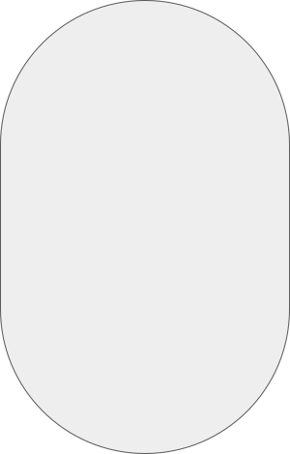

Miri Company
Presentation
2
CNN Model - Objective
Binary image classification using Yosemite_summer2winter Dataset
STEP 1
STEP 2
STEP 3
STEP 4
STEP 5
Data Pipeline
Data Augmentation
Dataset, DataLoader
Transfer Learning
Train, Validation, Test
Custom Image Dataset 설계
Albumentation Module
Dataset Creation (Labeling)
Dataset Concat (train, test)
Validation Dataset
DataLoader
Pretrained Model
Layer Parameter Freeze
FC Layer 조정
Epoch 50으로 설정
Tensorboard에 기록
Constructor
__getitem__
__len__
Training Dataset에 적용

Slide 6
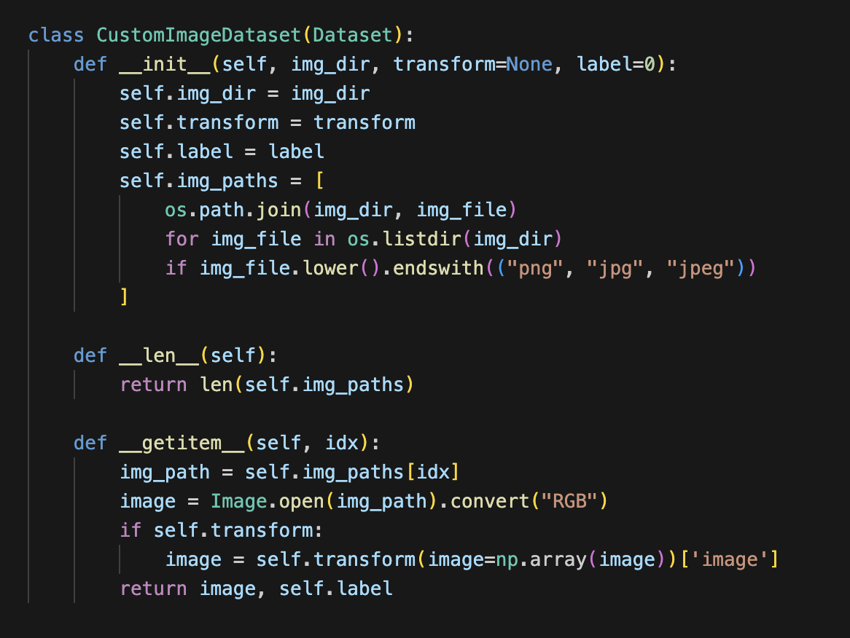
Miri Company
Presentation
2
CNN Model – Data Pipeline
PyTorch Dataset – 3 components: (data, label) for each index, length
· img_dir: current folder path
· transform: data augmentation method
· label: data labeling (0 – summer, 1 – winter)
· img_paths: [ file path in specific folder ]

Slide 7
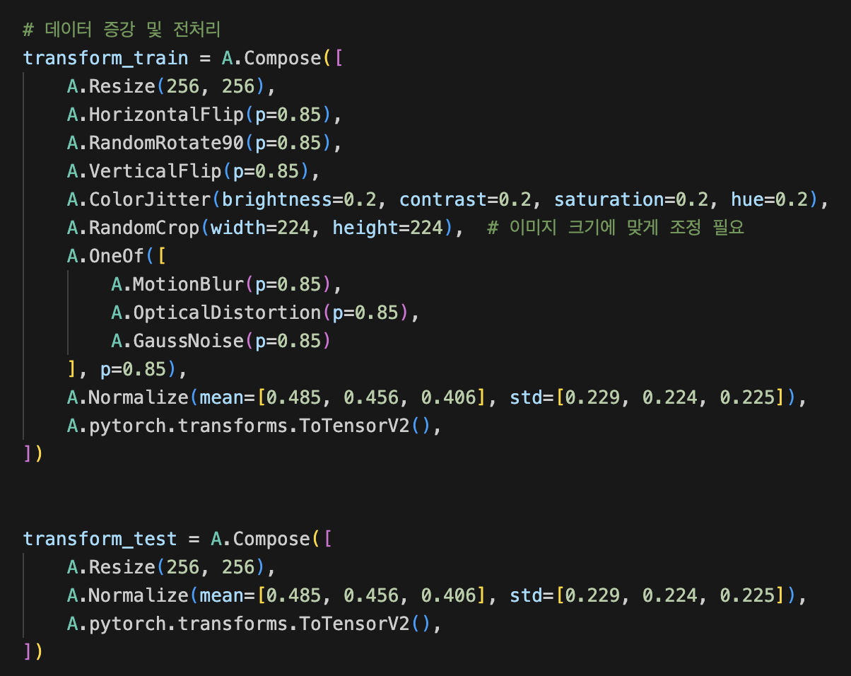
Miri Company
Presentation
2
CNN Model – Data Augmentation
Albumentation Library: Data Augmentation
Torchvision에서 제공하는 transform보다 더 빠르고 다양함
· Filp – Vertical(상하), Horizontal(좌우)
· ColorJitter – Brightness(밝기), contrast(대비), saturation(채도)
· RandomCrop (자르기)
· Noise(소음) – GaussianNoise, MotionBlur, OpticalDistortion
· Normalize(정규화) – mean & standard deviation for each channel

Slide 8
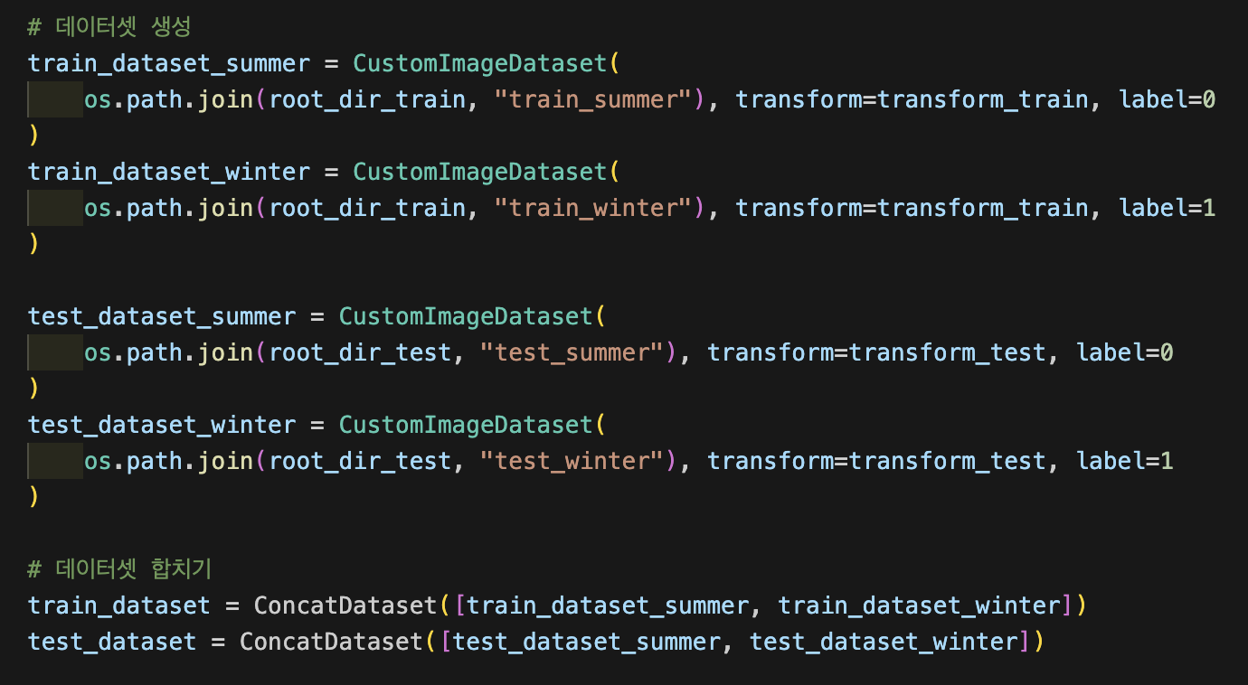
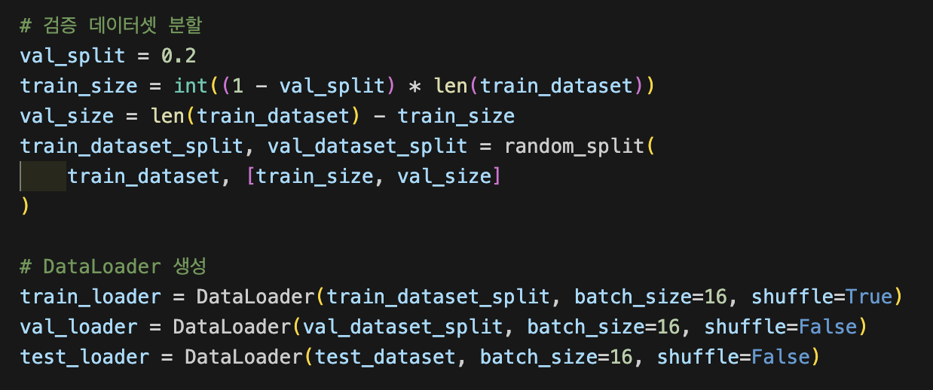
Miri Company
Presentation
3
CNN Model – DataSet, DataLoader
· Dataset Creation & Labeling (Summer – 0, Winter – 1)
· Dataset Concatenation – Train & Test
· Validation Set & DataLoader

Slide 9
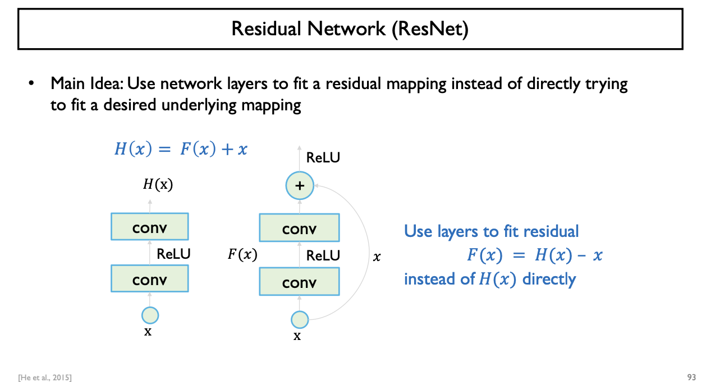
Miri Company
Presentation
4
CNN Model – ResNet
· Degradation Problem: Network가 깊어질수록 train & test error가 커지는 문제
· Residual Learning: H(x) = F(x) + x로 최종 Output을 구성하고 F(x) = H(x) – x가 된다
이를 Residual 이라 하며 결국 x는 학습대상이 아니므로 Residual을 학습
· Skip Connection: Residual이 0 되도록 학습, 미분을 할 때 F(x) = 0 으로 소실 되더라도,
H(x) = 0 + x 에서의 1로 gradient descent 문제를 해결 & ‘+’ Low Computational Problem

Slide 10
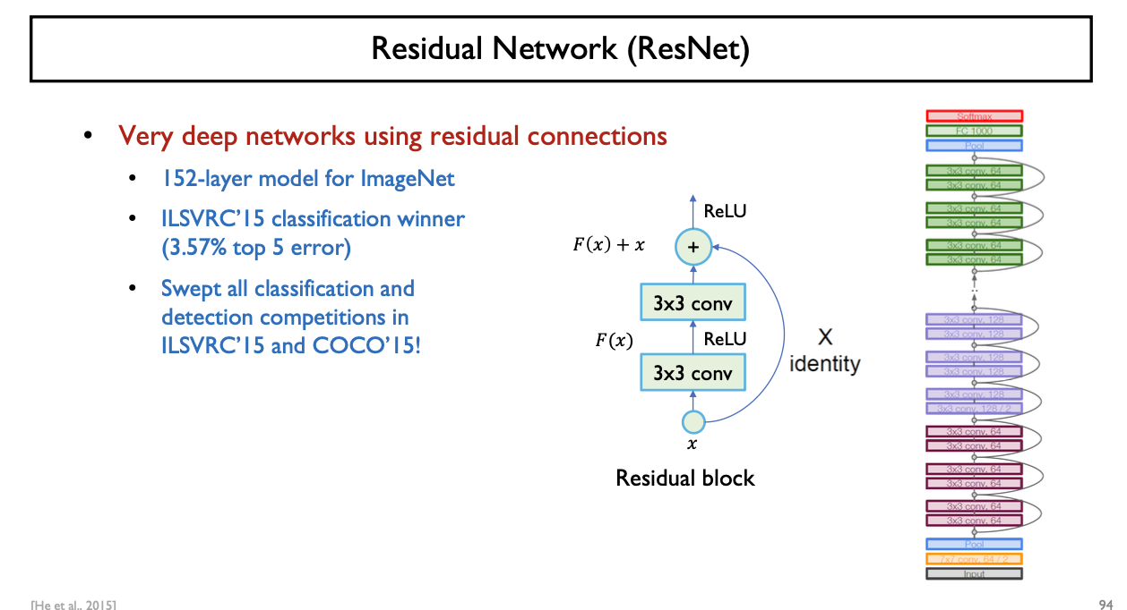
Miri Company
Presentation
4
CNN Model – ResNet
· ILSVRC 2015 Winner: Residual Block이라는 Module을 깊게 쌓아 152개의 Layer를 가짐
· vs VGGNet: VGGNet 보다 8배나 많은 Layer 개수를 가지지만 lower complexity
· Model Architecture: Residual Block으로 구성됨
Identity Mapping에 Zero-padding or 1 X 1 Convolution을 사용해 Channel의 개수 증가
Feature Map size를 줄이기 위하여 Stride = 2를 사용

Slide 11
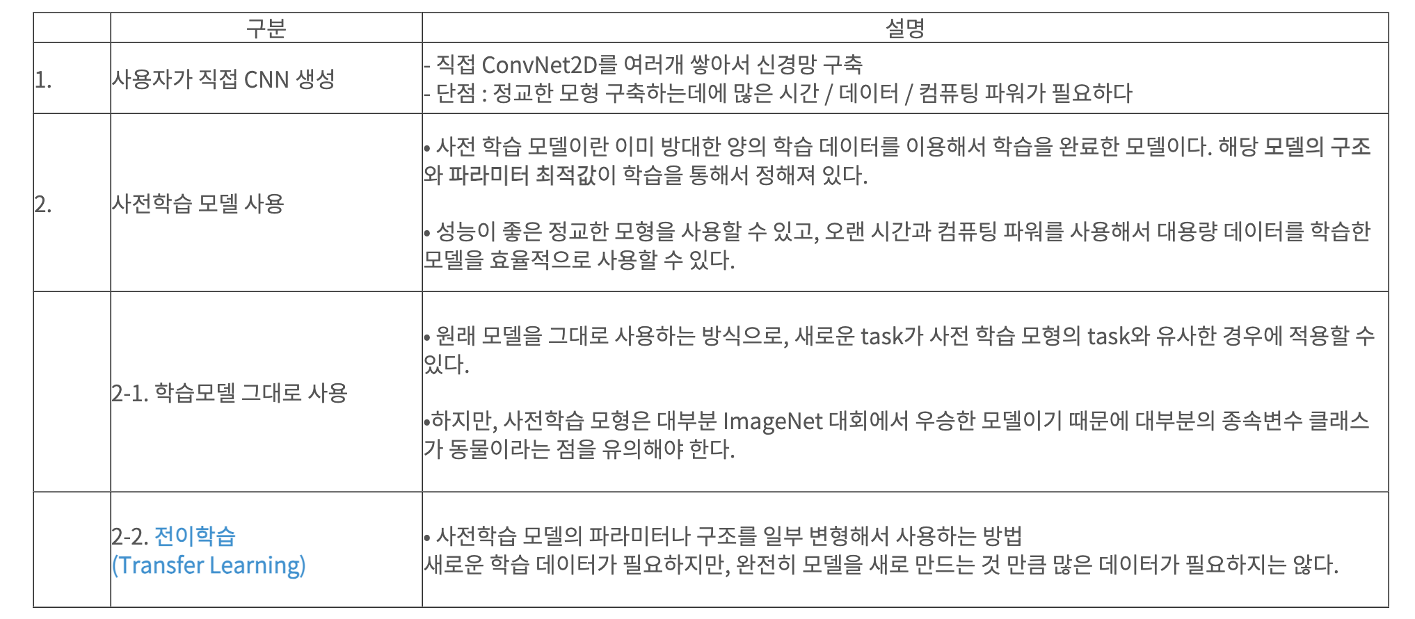
Miri Company
Presentation
4
CNN Model – Transfer Learning
· CNN – 2 Image Classification Method

Slide 12
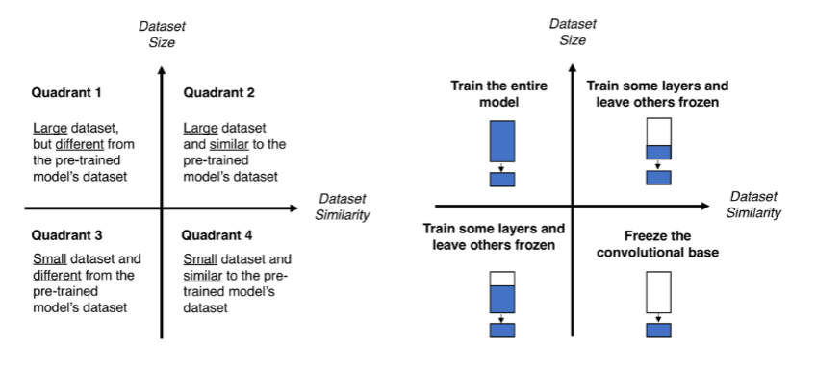
Miri Company
Presentation
4
CNN Model – Transfer Learning
· Transfer Learning
ImageNet으로 Pre-trained된 Backbone을 이용하여
feature map extraction
4-Category에 따라 fc-layer만 설계히여 fine-tuning
· Current Task의 data size
· pretrained model과의 dataset or task similarity
· Fine Tuning Point
- learning_rate를 매우 작게 설정 (1/10 수준)
- Stable한 SGD Optimizer를 이용
- Bottleneck Feature만 따로 저장하여 FC Layer만 학습
(Data Augementation의 필요 없이 Dataset size가 큰 경우)

Slide 13
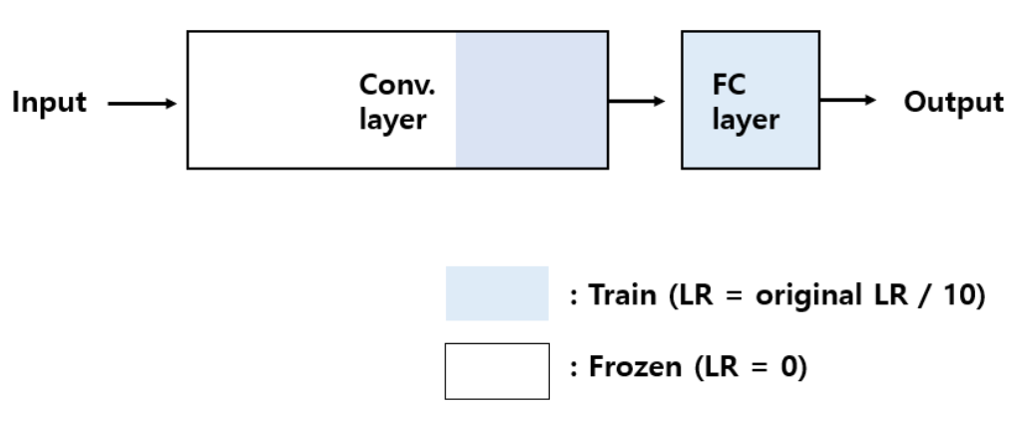
Miri Company
Presentation
4
CNN Model – Transfer Learning
· Transfer Learning
- Task Data Size ↓
- Dataset Similarity ↓
· Last Convolution Layer: unfreeze
· New FC Layer w/ dropout
· Optimizer – learning_rate를 layer 별로 조정

Slide 14
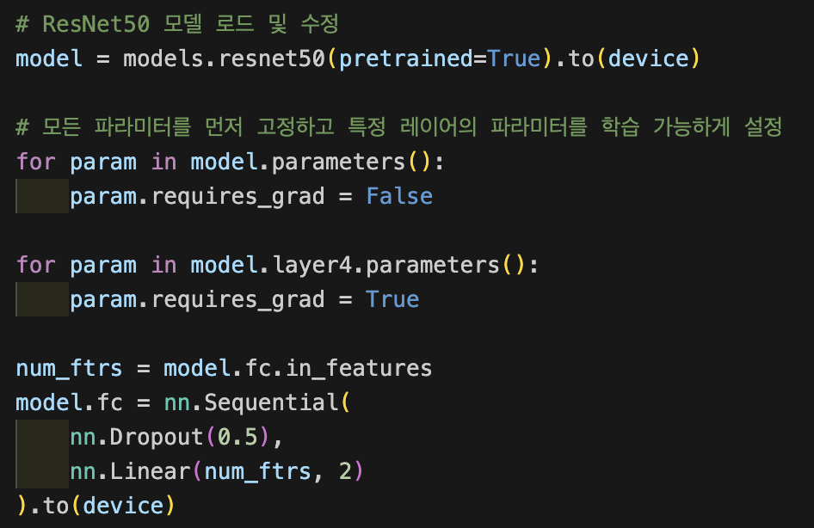
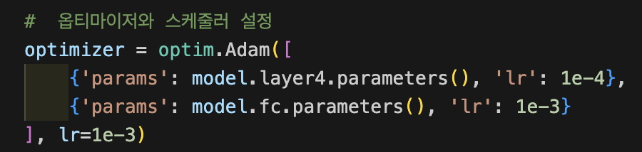
Miri Company
Presentation
4
CNN Model – Transfer Learning 1
· Pretrained Model – resnet(18, 34, 50, 101)
· Last Convolution Layer: unfreeze
· New FC Layer w/ dropout
· Optimizer – learning_rate를 layer 별로 조정
· Scheduler– learning_rate를 active 하게 조정

Slide 15
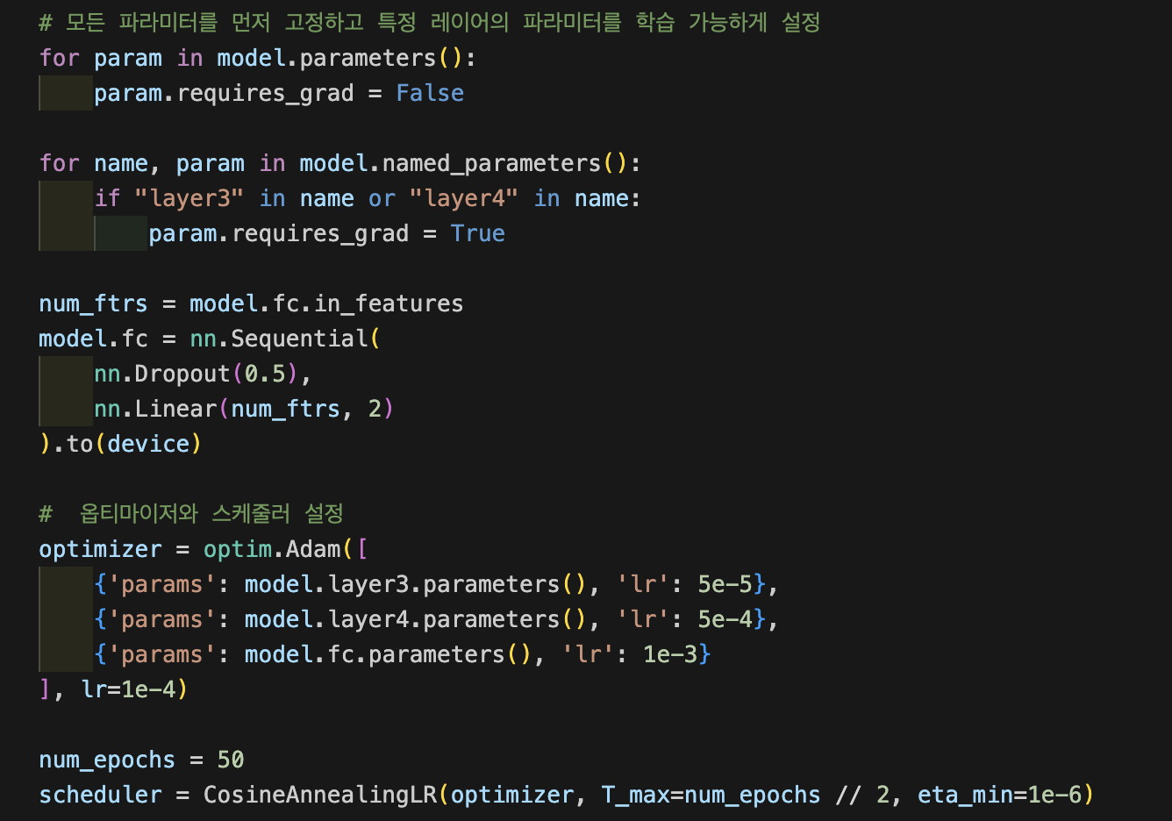
Miri Company
Presentation
4
CNN Model – Transfer Learning 2
· Pretrained Model – resnet(18, 34, 50, 101)
· 3(the layer before last), 4th(last) Convolution Layer: unfreeze
· New FC Layer w/ dropout
· Optimizer – learning_rate를 layer 별로 더 세밀하게 조정 & weight decay 추가
· Scheduler– learning_rate를 active 하게 조정

Slide 16
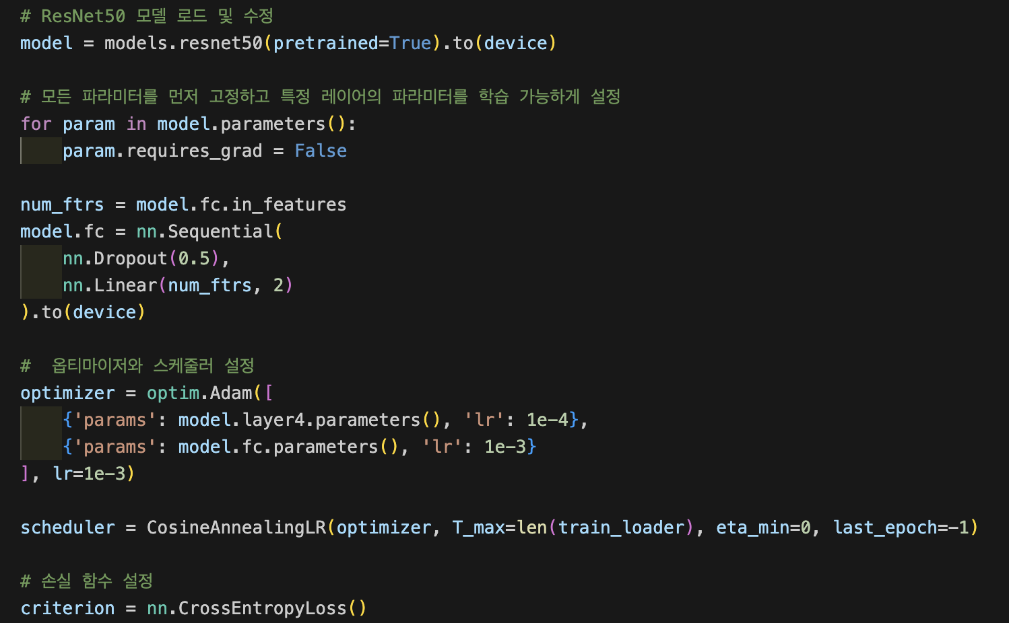
Miri Company
Presentation
4
CNN Model – Transfer Learning 3
· Pretrained Model – resnet(18, 34, 50, 101)
· All Layer: Freeze
· New FC Layer w/ dropout
· Optimizer – learning_rate를 layer 별로 조정

Slide 17
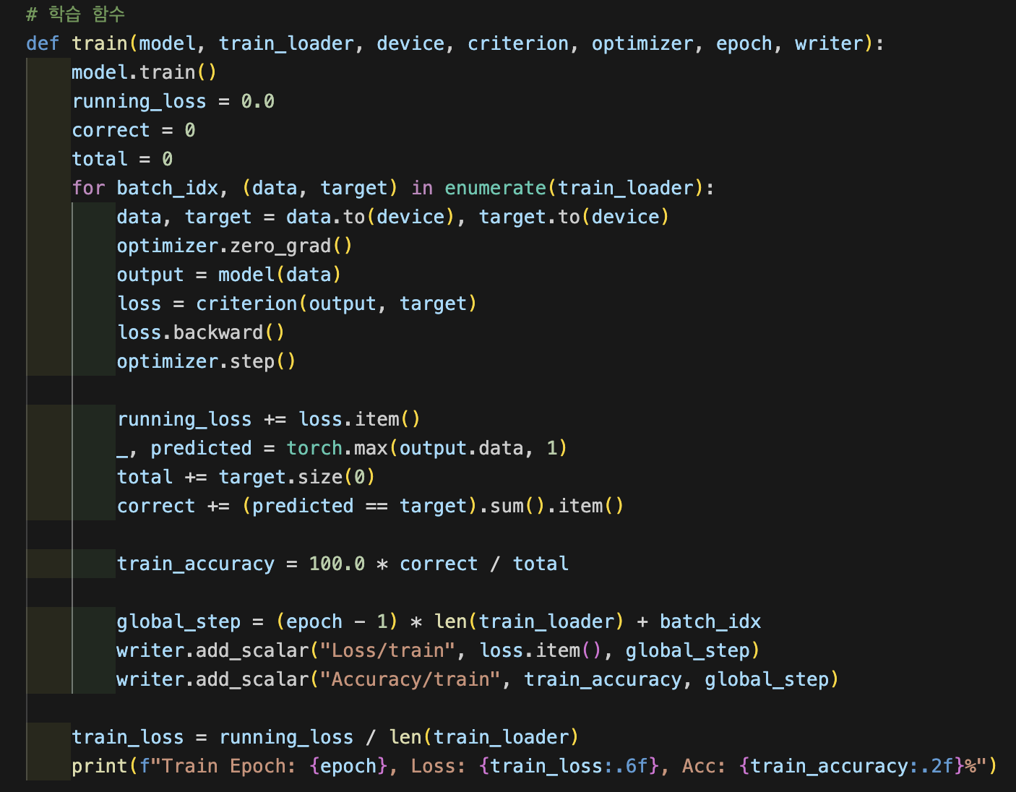
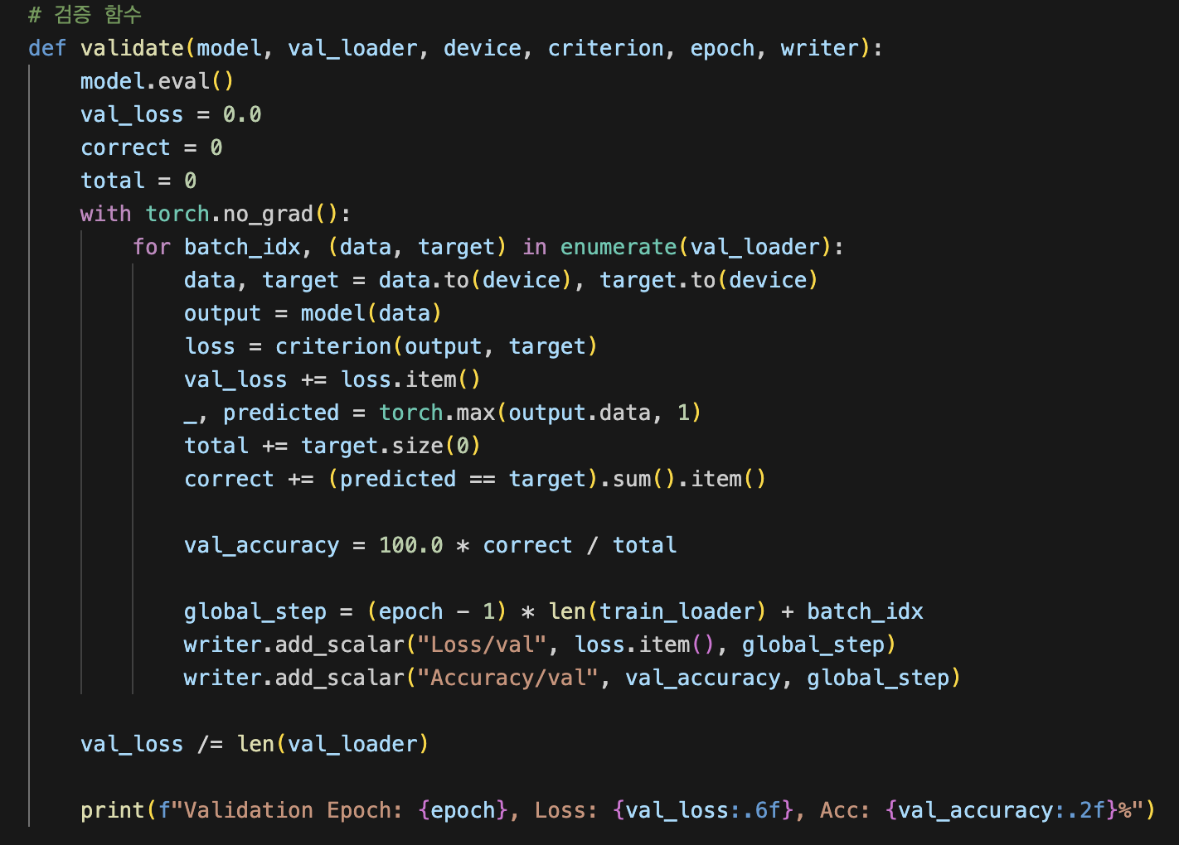
Miri Company
Presentation
5
CNN Model – Train, Validation, Test

Slide 18
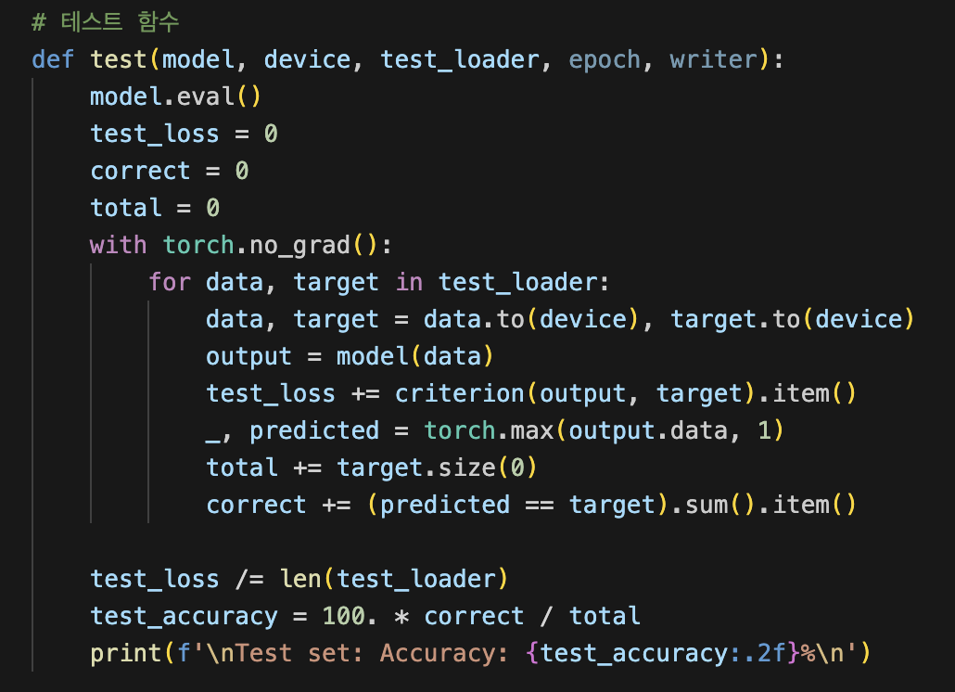
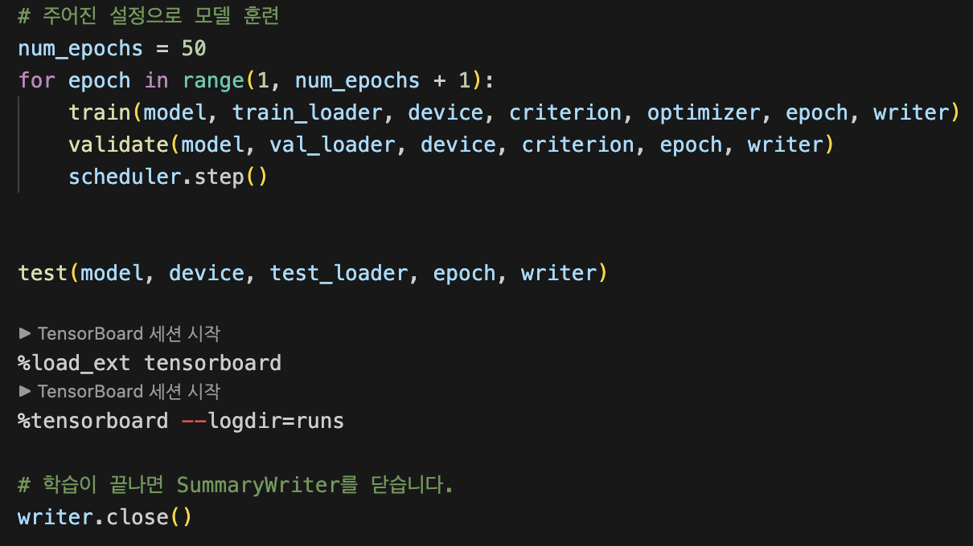
Miri Company
Presentation
5
CNN Model – Train, Validation, Test

Slide 19





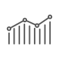
Miri Company
Presentation
5
CNN Model – Result Analysis
Hyper Parameter
Transfer Learning
- batch_size: 16, 32, 64 성능 차이 X – 32로 선택
- learning_rate: Transfer Learning (Layer별로 다름)
- Conv4: , FC Layer: , weight_decay
- epoch: 50 넘어가면 overfitting (validation score ↓)
- Convolutional Layer 4만 unfreeze: Test Acc - 85.07%
- Convolutional Layer 3, 4만 unfreeze: Test Acc - 82.27%
- All Layer freeze: Test Acc – 79.52%
Hyper Parameter
Transfer Learning
Model Architecture
Optimizer
- ResNet: 18. 34, 50, 101 성능 거의 차이 X - resnet34↑
- EfficientNet
- DenseNet
- Adam
- SGD
Model Architecture
Optimizer

Slide 20
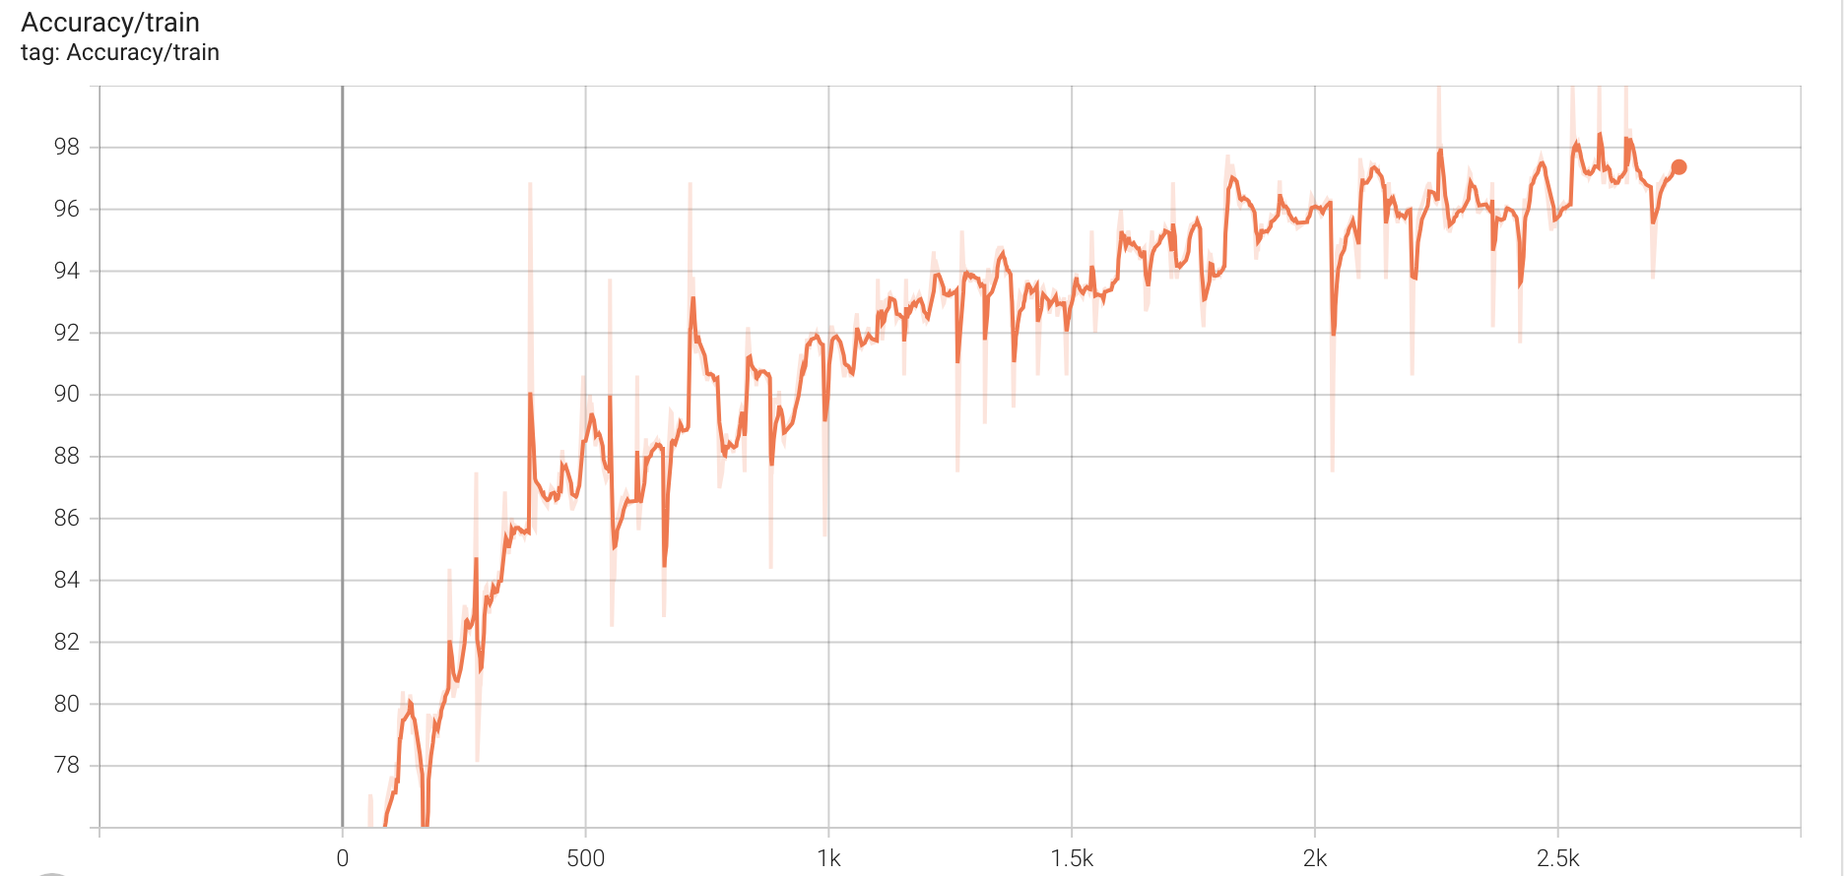
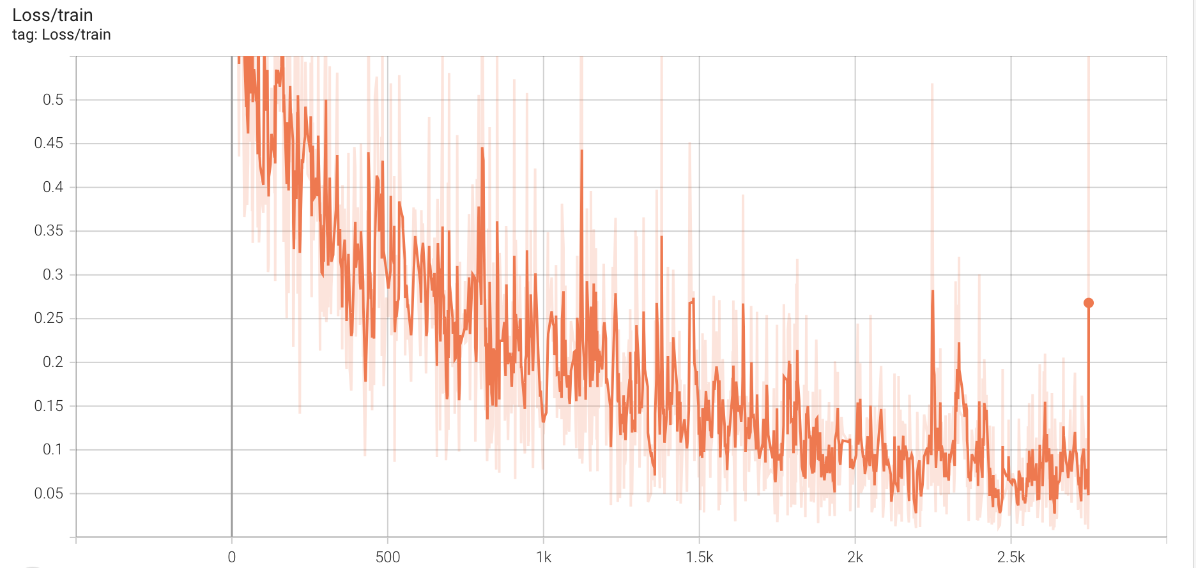
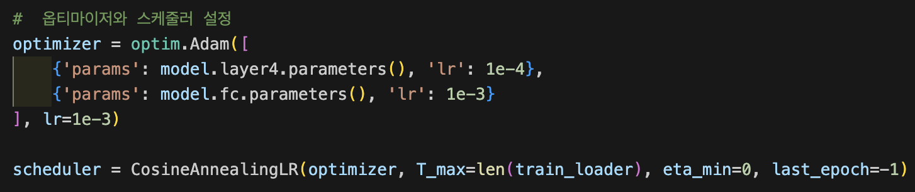
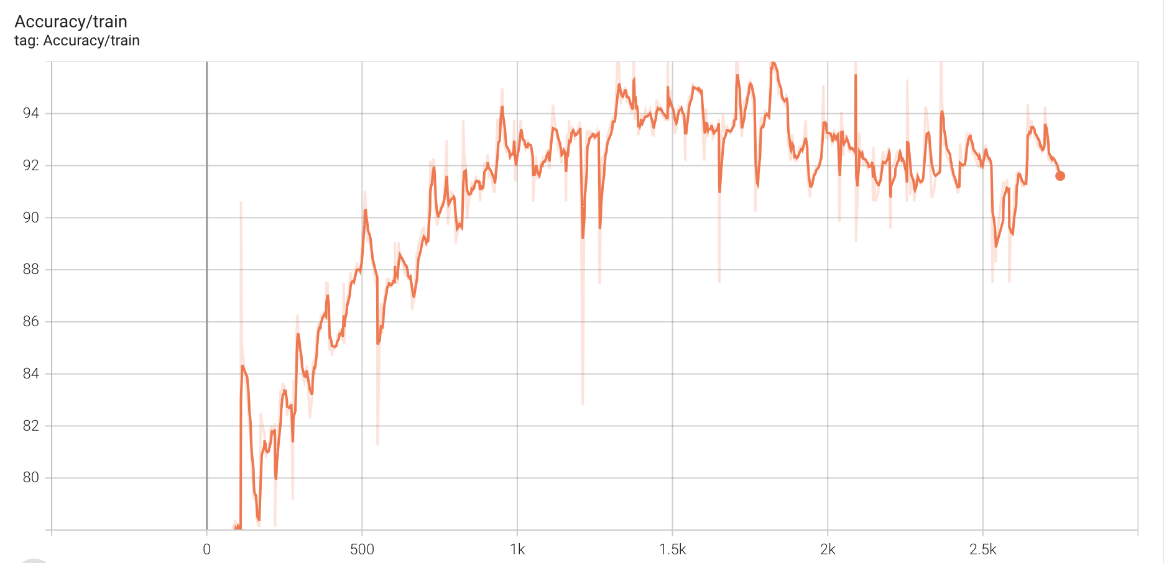
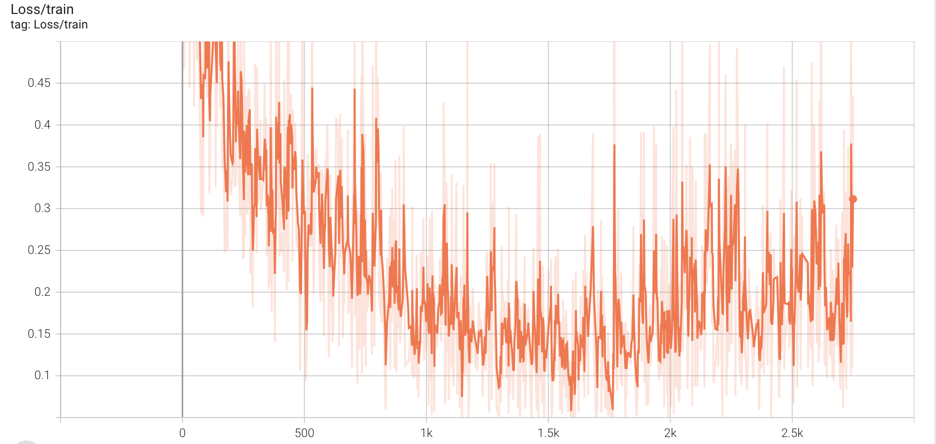
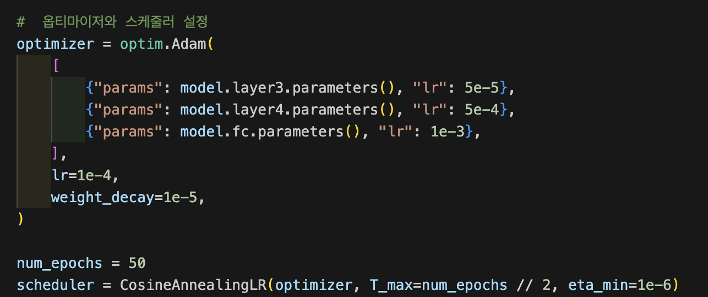
Miri Company
Presentation
5
CNN Model – Result Analysis
· learning_rate Comparison
[Fixed Conditions]
- Model Architecture: ResNet34
- Hyperparameter : batch_size=32, epoch=50, CosineAneealingLR
- Transfer Learning: Conv4 Layer unfreeze + FC Layer
- Optimizer: Adam
[learning_rate]
· Train Accuracy_1
· Train Loss_1
Test Accuracy 85.07%
Test Accuracy 81.90%
· Train Accuracy_2
· Train Loss_2

Slide 21
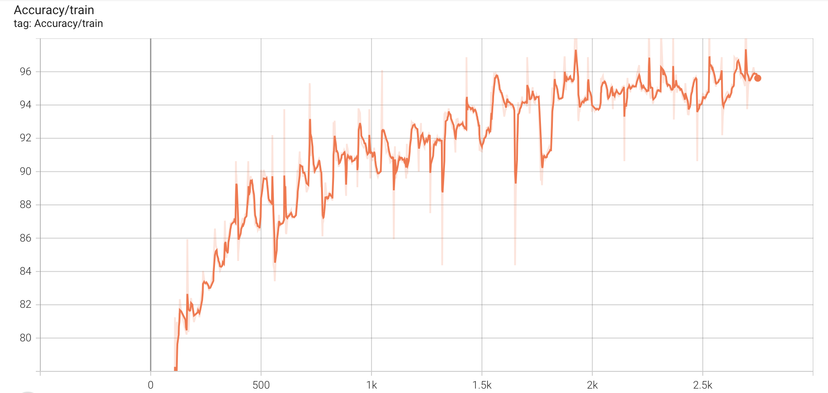
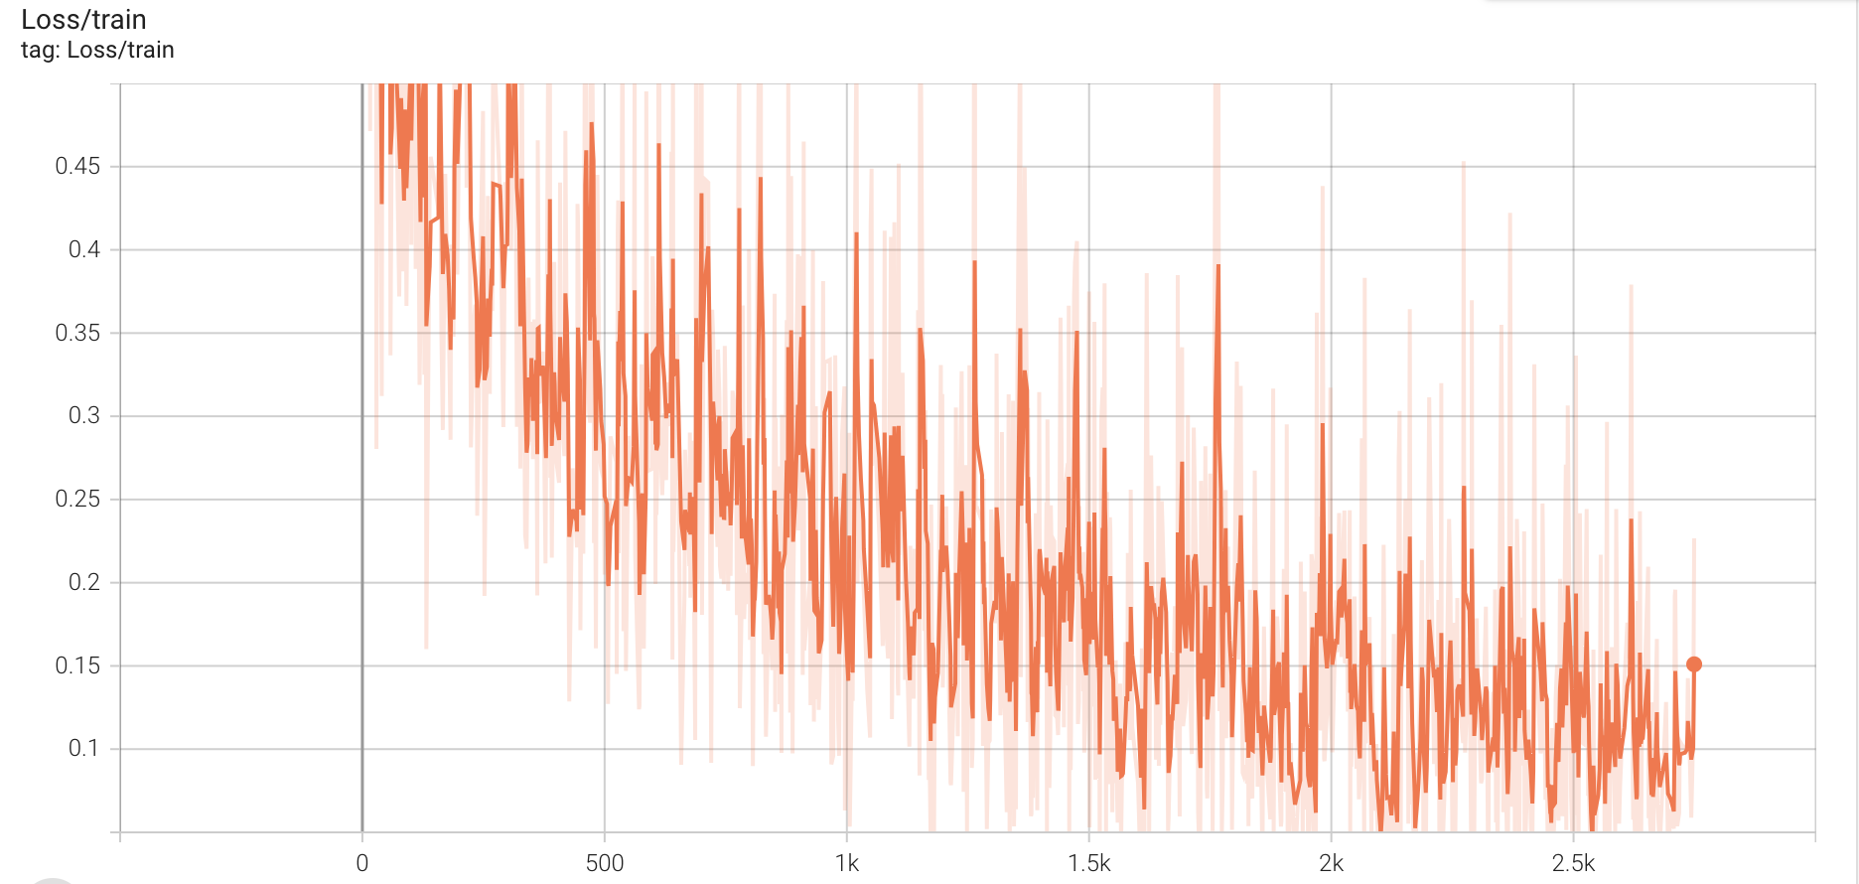
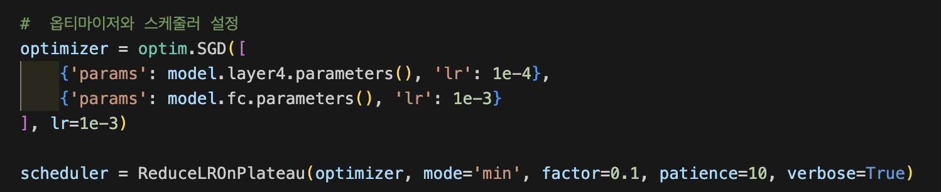
Miri Company
Presentation
5
CNN Model – Result Analysis
· Scheduler Comparison
[Fixed Conditions]
- Model Architecture: ResNet34
- Hyperparameter : batch_size=32, epoch=50, learning_rate
- Transfer Learning: Conv4 Layer unfreeze + FC Layer
- Optimizer: Adam
[Scheduler]
CosineAnnealingLR: Test Accuracy 85.07%
· Train Accuracy_1
· Train Loss_1
`
· Train Accuracy_2
· Train Loss_2
ReduceLRonPlateau: Test Accuracy 84.19%

Slide 22
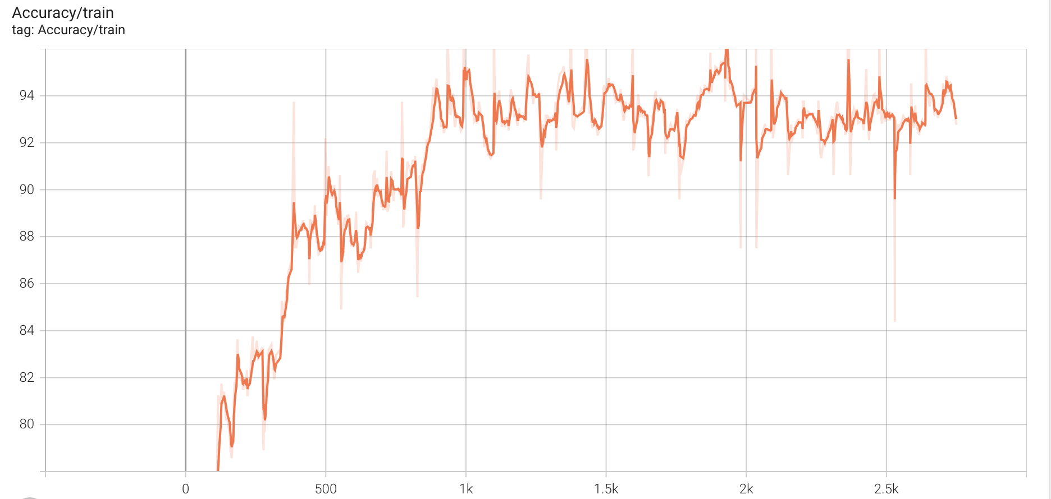
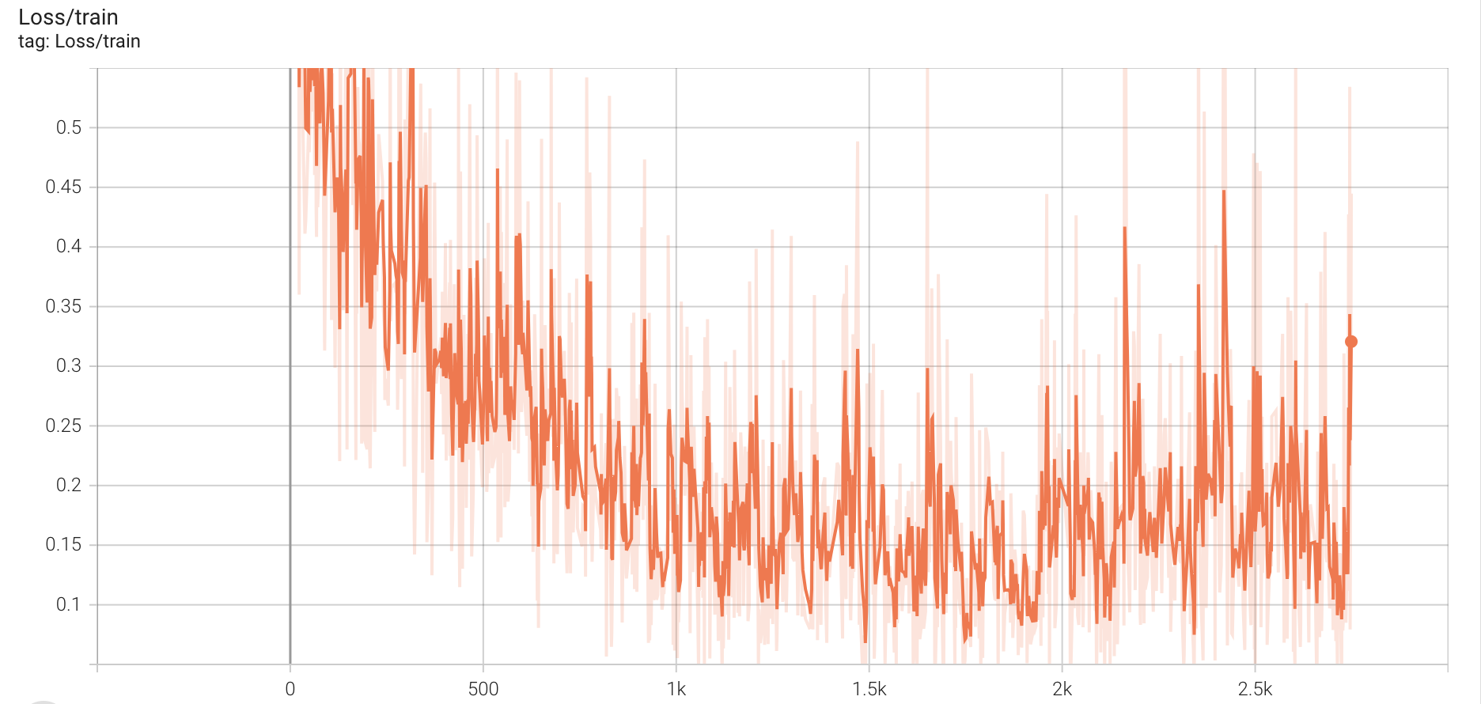
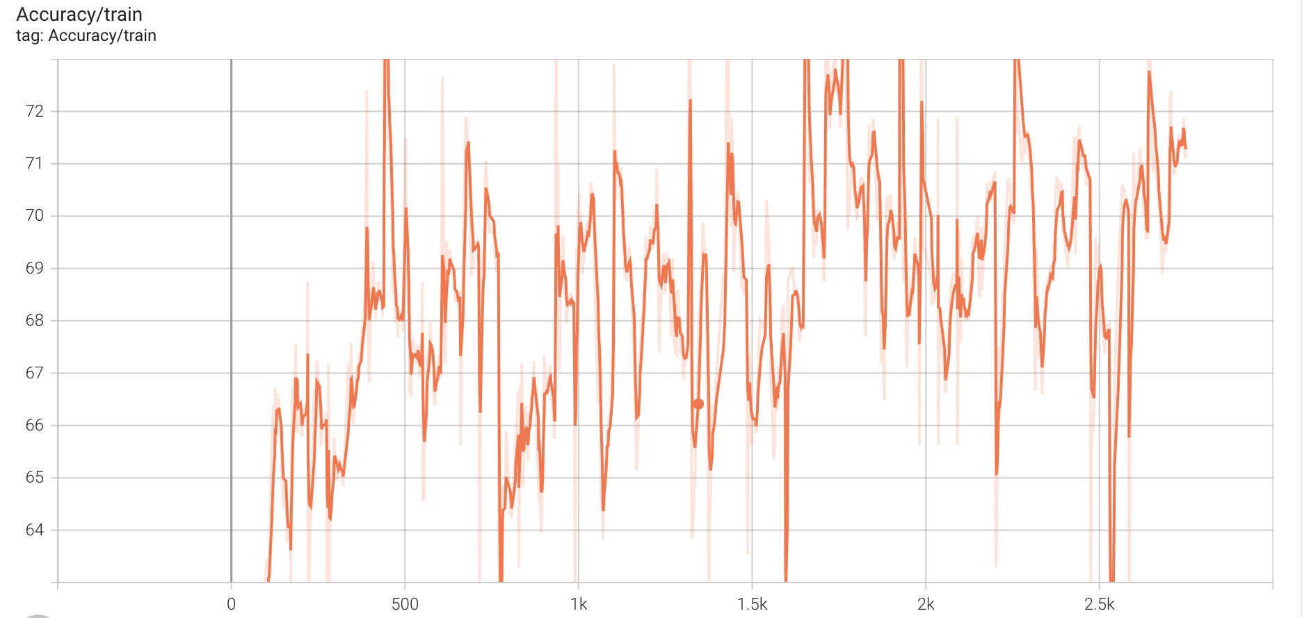
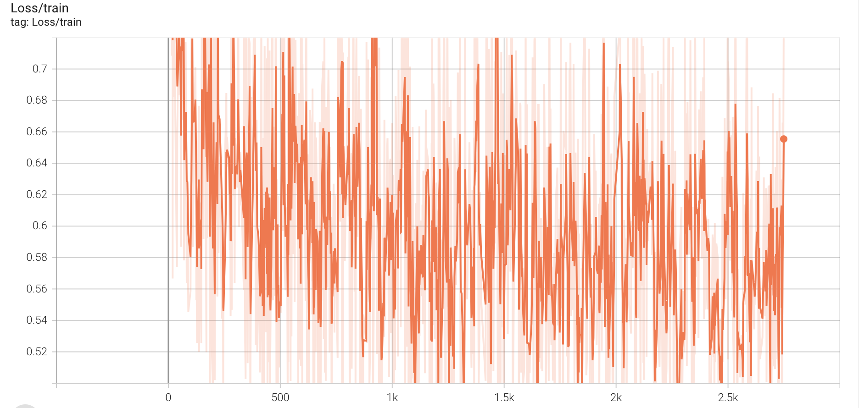
Miri Company
Presentation
5
CNN Model – Result Analysis
· Transfer Learning Comparison
[Fixed Conditions]
- Hyperparameter : batch_size=32, learning_rate_1, epoch=50
- Model Architecture: ResNet34
- Optimizer: Adam
[Transfer Learning]
- Convolutional Layer 4만 unfreeze: Test Acc - 85.07%
- Convolutional Layer 3, 4만 unfreeze: Test Acc - 82.27%
- All Layer freeze: Test Acc – 79.52%
· Train Accuracy_1
· Train Loss_1
· Train Accuracy_3
· Train Loss_3
· Train Accuracy_2
· Train Loss_2

Slide 23
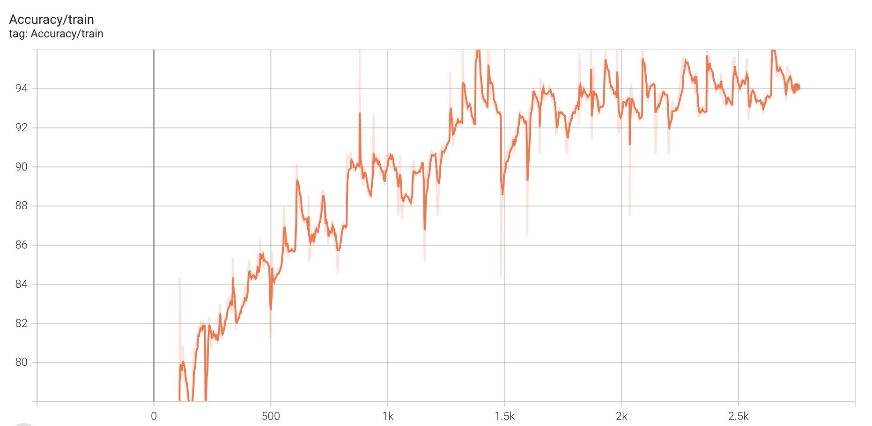
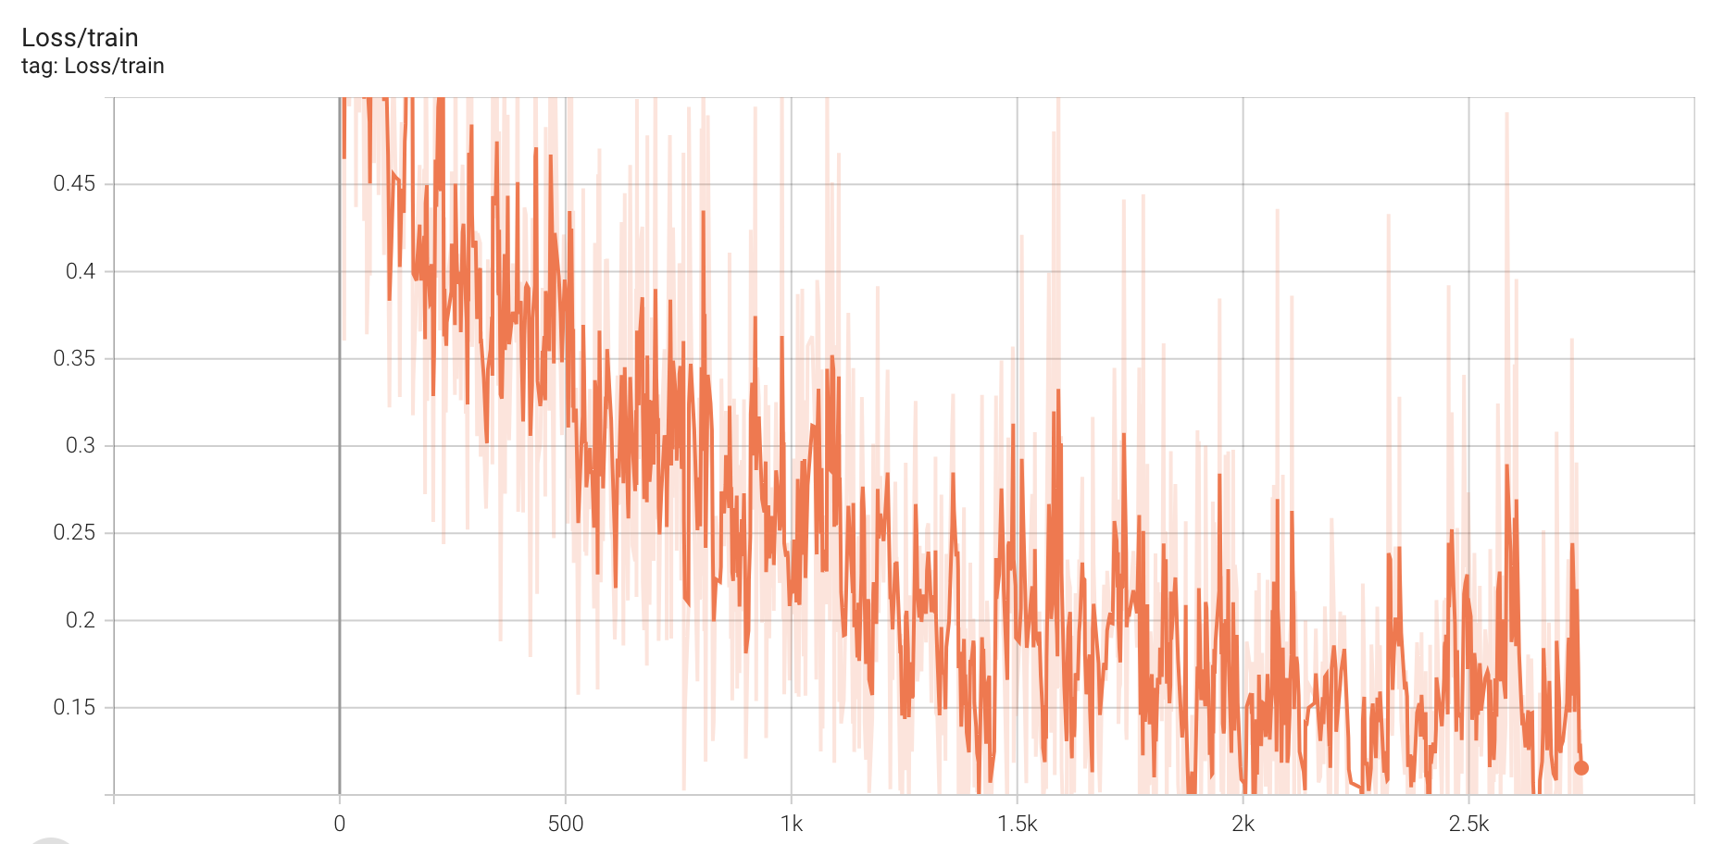
Miri Company
Presentation
5
CNN Model – Result Analysis
· Model Architecture Comparison
[Fixed Conditions]
- Hyperparameter : batch_size=32, learning_rate_1, scheduler, epoch-50
- Transfer Learning: Conv4 Layer unfreeze + FC Layer
- Optimizer: Adam
[Model Architecture]
- ResNet18, 34, 50, 101
- DenseNet
· Train Accuracy_resnet34
· Train Loss_resnet34
- ResNet Test Accuarcy: 84.46% , 85.07%, 84.46%, 84.64%
- DenseNet Test Accuarcy: 84.46%
· Train Accuracy_densenet121
· Train Loss_densenet121

Slide 24
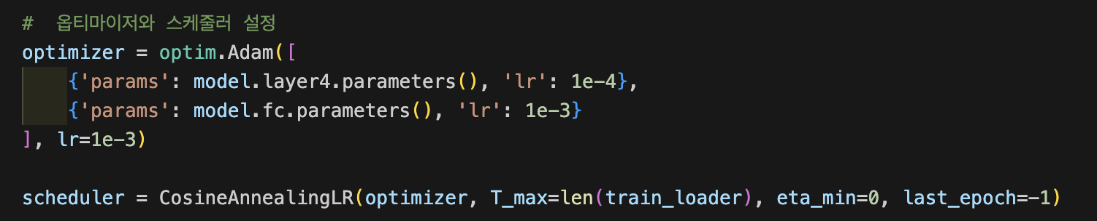
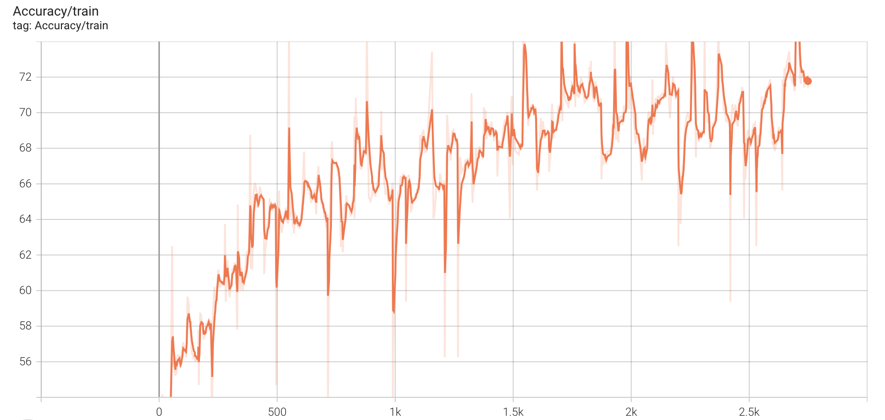
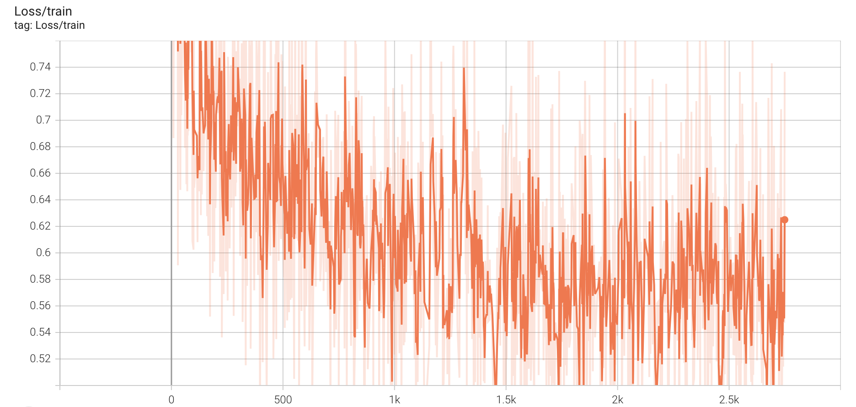
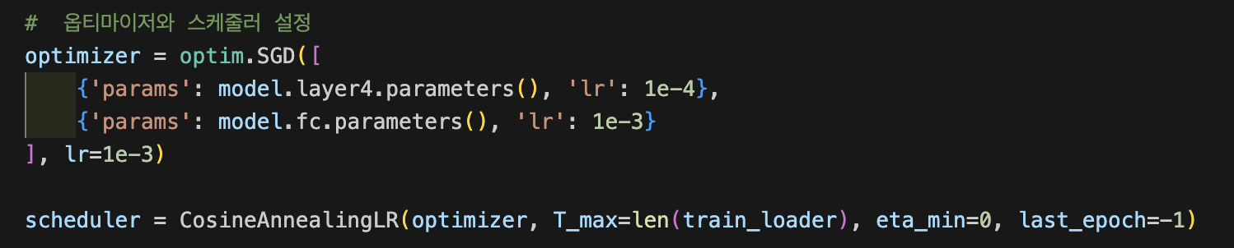
Miri Company
Presentation
5
CNN Model – Result Analysis
· Optimizer Comparison
[Fixed Conditions]
- Hyperparameter : batch_size=32, learning_rate_1, scheduler, epoch=50
- Model Architecture: ResNet34
- Convolutional Layer 4만 unfreeze
[Optimizer]
- Adam
- SGD (epoch 수를 더 늘렸으면 다를 가능성 존재)
· Train Accuracy_Adam
· Train Loss_Adam
Test Accuracy 85.07%
Test Accuracy 79.16%
· Train Accuracy_SGD
· Train Loss_SGD

Slide 25





Miri Company
Presentation
Thank You!
경청해주셔서 감사합니다.
Manager. 김미리
E-Mail. miri@mcompany.com
Tel. 070.1234.5678
www.miricanvas.com

